Slide 1
Dentistry Project Updates

Slide 2
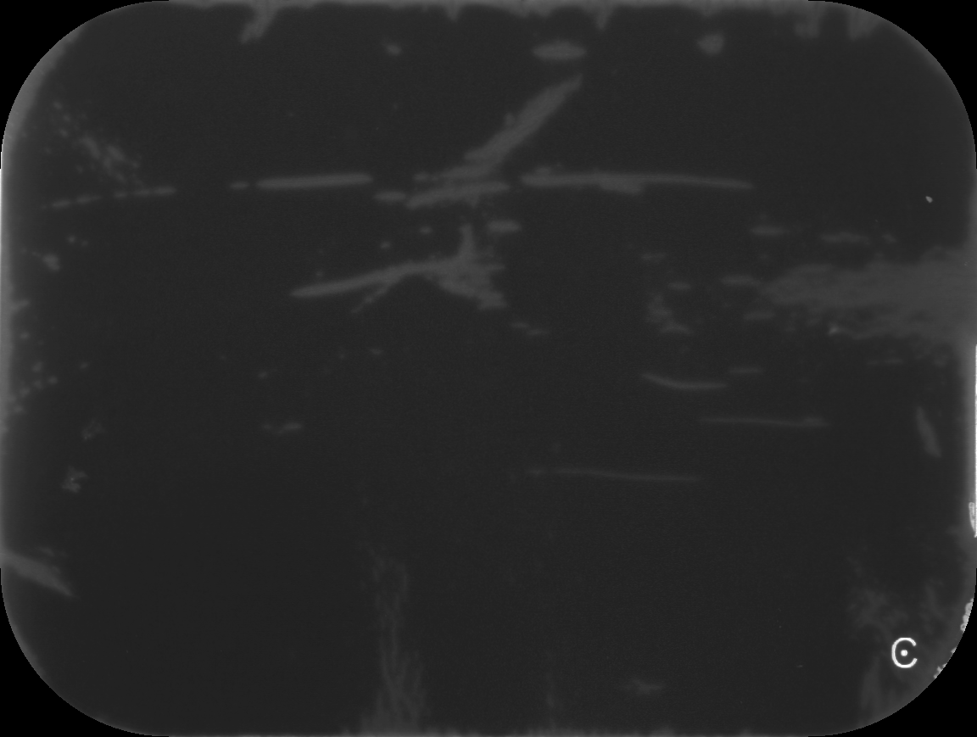
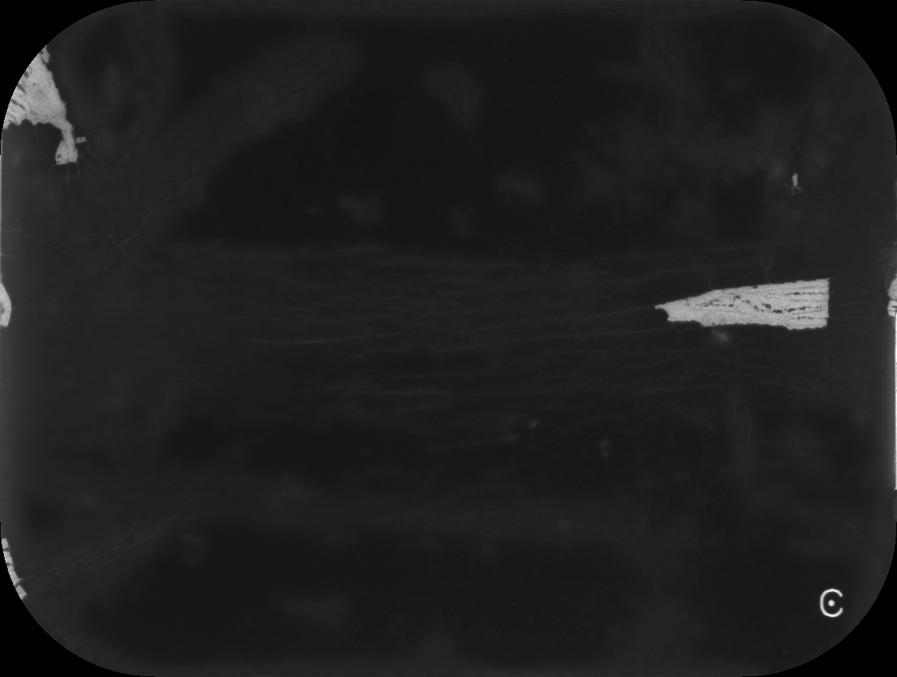
The Artifact Characterization Pipeline
1. Segmentation
2. Feature computation
3. Clustering
Characterization

Slide 3
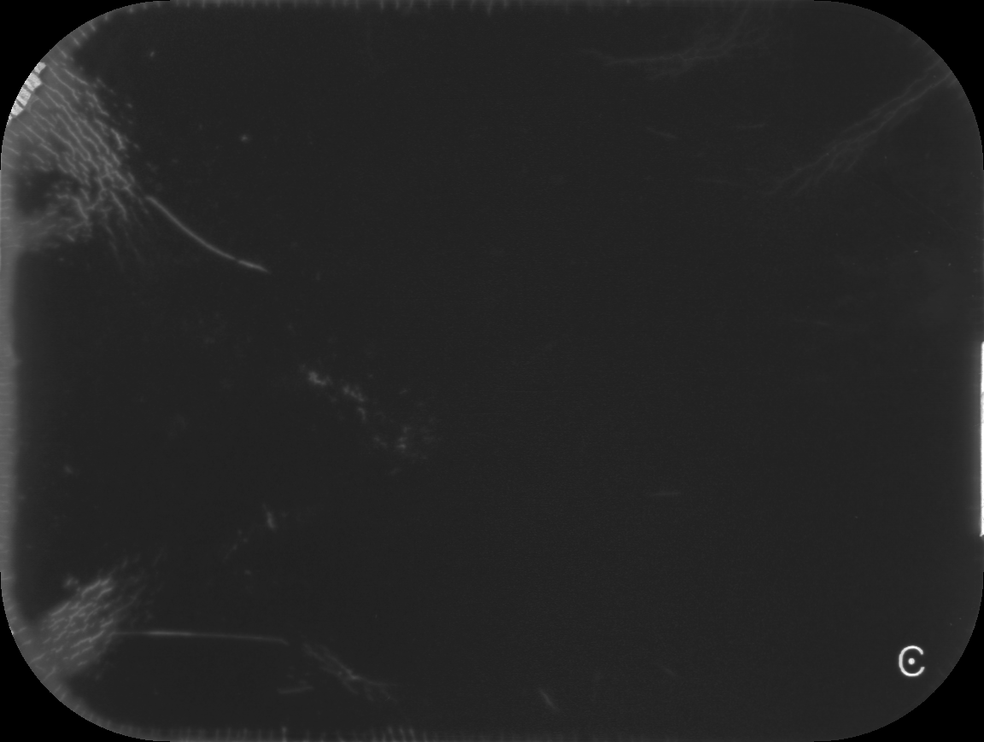


1. Segmentation
Removal of the “C”
VS
1. Find region of maximum
cross-correlation with
template
2. Set any points in that region that are
below 45 in intensity to 0

Slide 4
1. Segmentation
Segment images with DBSCAN
Improvements since last time:
Less aggressive thresholding (65 / 255 pixels)
Stayed with Euclidean distance function
Did not scale data to [0, 1], used original axes of:
[0, 1152], [0, 869], [0, 255]
Increased minimum number of points to 20
Decreased epsilon search radius to 20

Slide 5
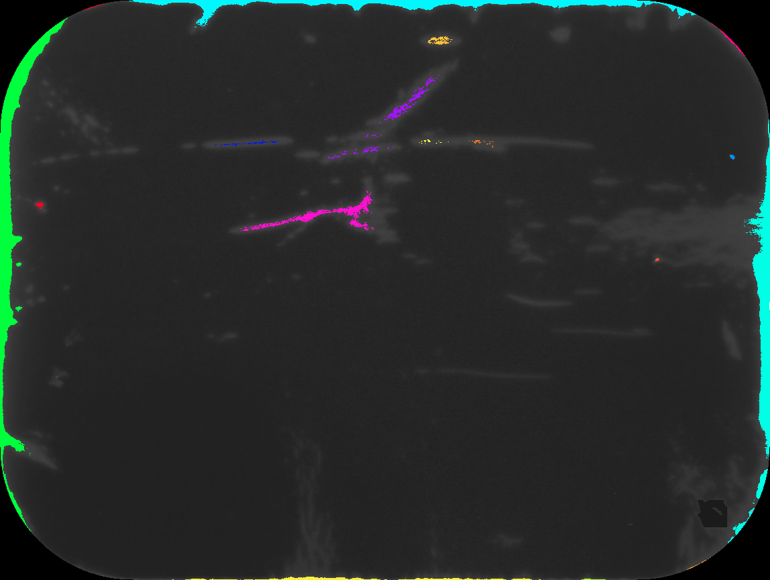
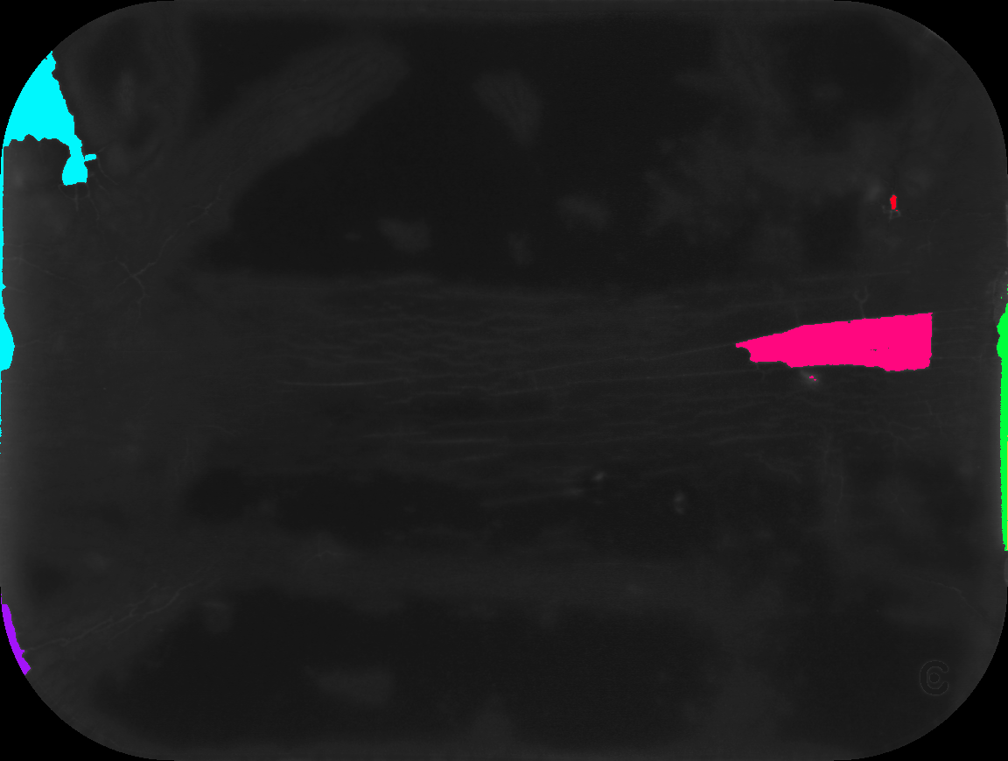
1. Segmentation
Segmented images

Slide 6






1. Segmentation

Slide 7
2. Feature Computation
Area (number of pixels)
Volume (sum of intensity)
Length and width (delta X, delta Y)
Location (x and y coordinates of the centroid)
Intensity (max and median intensity)
Shape (categorical variable: line, triangle, rectangle, circle)

Slide 8
2. Feature Computation
Shape detection: contour approximation
Use another shape with less vertices to approximate the contour.
Epsilon: precision factor, the maximum distance from the contour to the approximated contour.
Returns a list of vertices for the approximated contour.
2 vertices: line; 3 vertices: triangle; 4 vertices: rectangle; more than 4: circle.

Slide 9
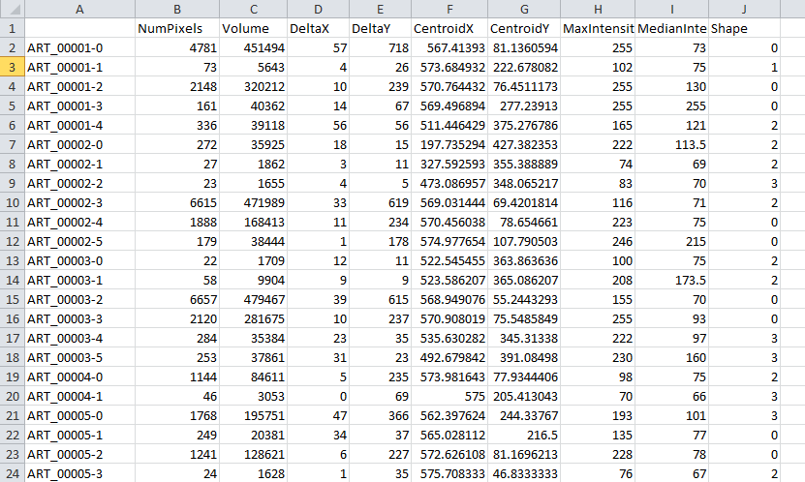
2. Feature Computation

Slide 10
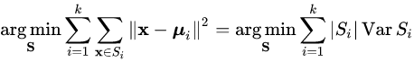
3. Clustering
K Means ----numerical variables
Specify k groups, and minimize the intra-cluster variance
Simple algorithm:
Randomly initialize the centroid for each cluster
Calculate the L2 distance of each data point to all the centroids
Assign each point to the cluster of the closest centroid
Recalculate the centroid for each cluster
Repeat until convergence

Slide 11
3. Clustering
K Modes ----categorical variables
Uses modes instead of means to represent each cluster
Measure the dissimilarities between a point and a cluster instead of the L2 distance.
Similar ideas as k-means: initialize, measure the dissimilarities, assign points, recalculate the mode, measure the dissimilarities again…..until convergence.

Slide 12
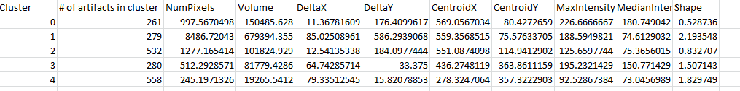
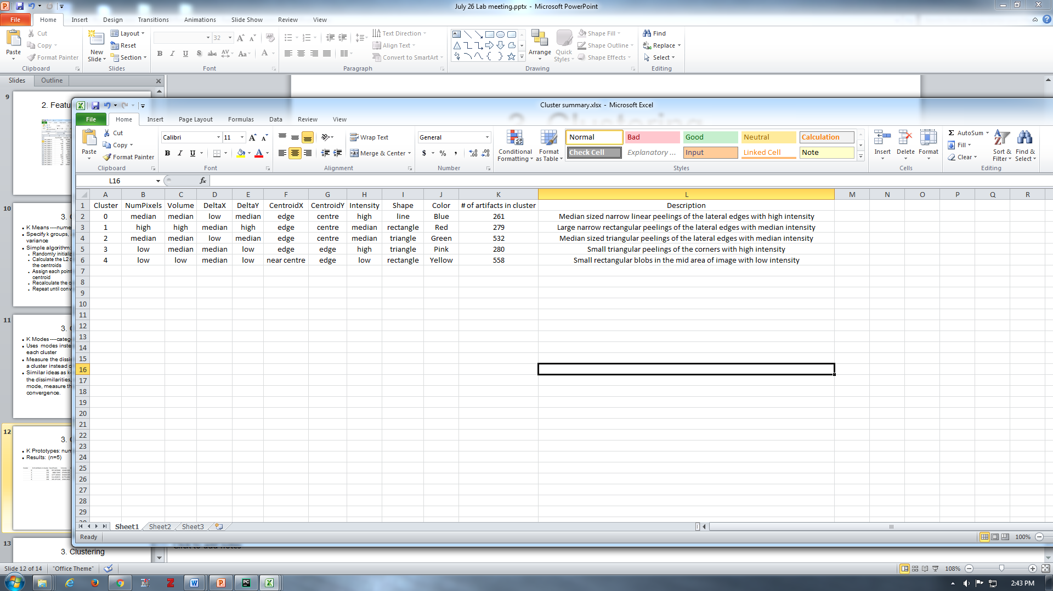
3. Clustering
K Prototypes: numerical and categorical
Results: (n=5)

Slide 13
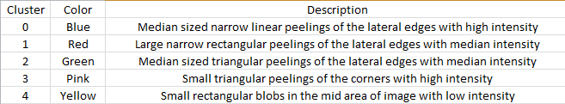
3. Clustering

